Slide 1

APPLIED DATA ANALYTICS ASSIGNMENT STUDENT NAME-NITHIN UMAMAHESH STUDENT NUMBER - 2996085
TOPIC - Survey on mental illness in technology workplace 2014-2016

Slide 2
Attributes and types (detailed description of all the attributes is included in the document)
self-employed
mental_disorder
family_history
Work_interfere
no_employees
remote_work
Benefits
care_options
wellness_program
Anonymity
mental_health_consequence
family_and_friends
Co-workers
mental_health_interview
obs_consequence

Slide 3
Problem statement
Are the employees with mental disorder facing any problems discussing their mental health issues with the employer?
Is the employee aware of the benefits and care options provided by the employer or company?
What are the factors influencing the mental health of the employee at the workplace?
What measures can be taken by the company so that their employee feels comfortable discussing about mental health issue?

Slide 4
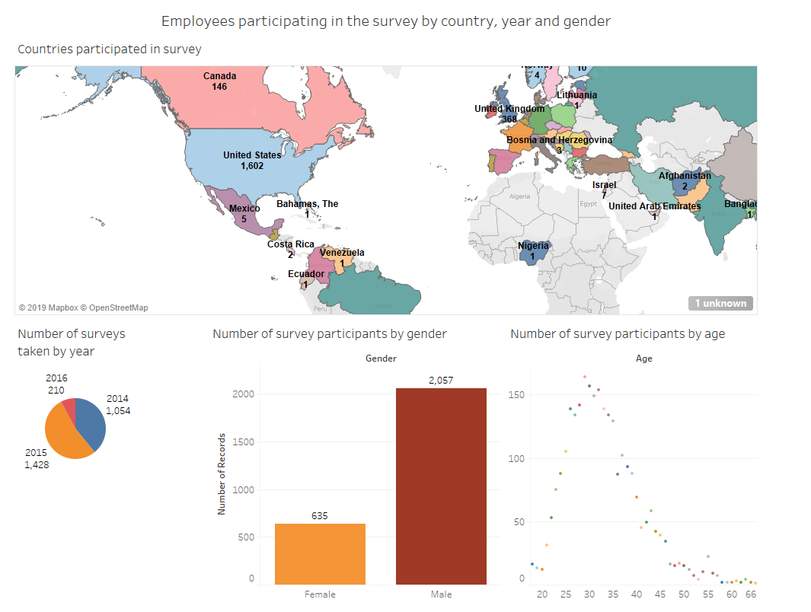
DASHBOARD 1

Slide 5
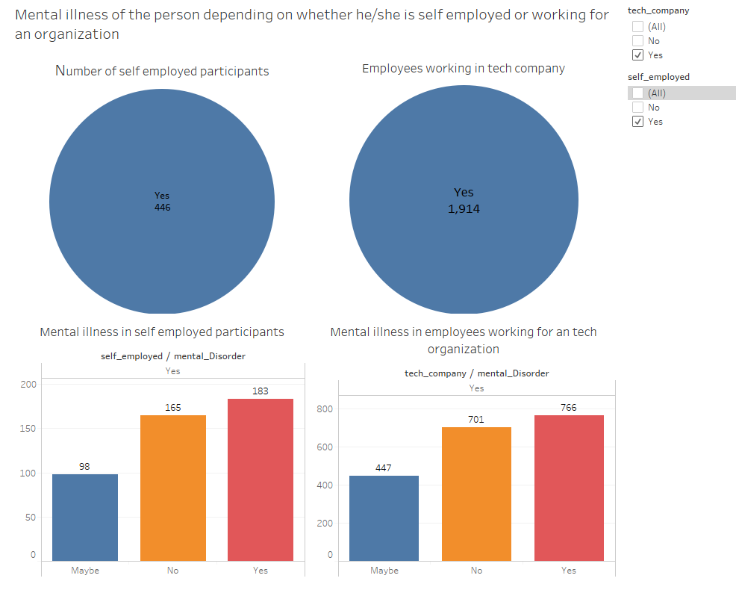
DASHBOARD 2

Slide 6
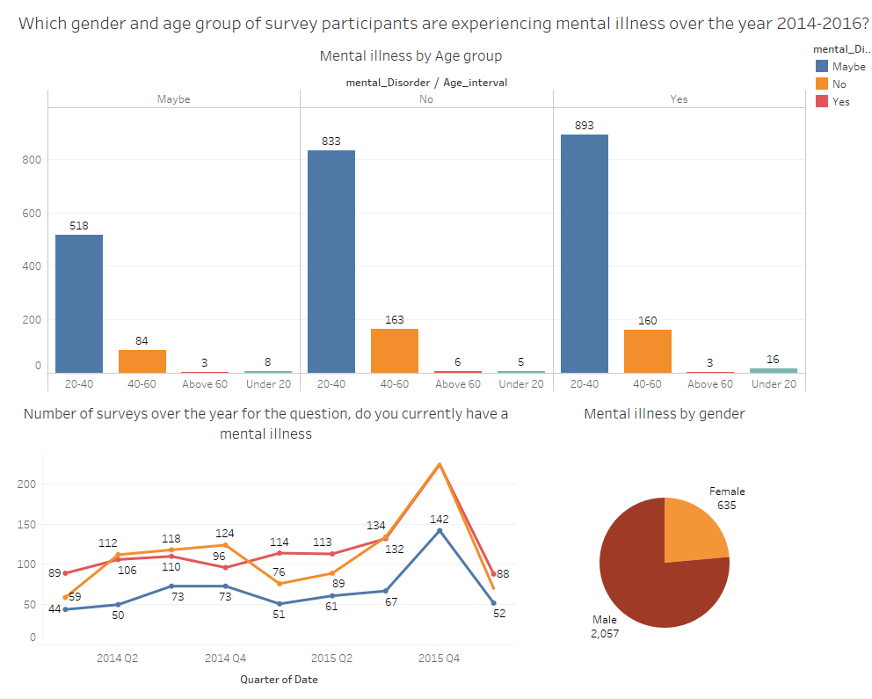
DASHBOARD 3

Slide 7
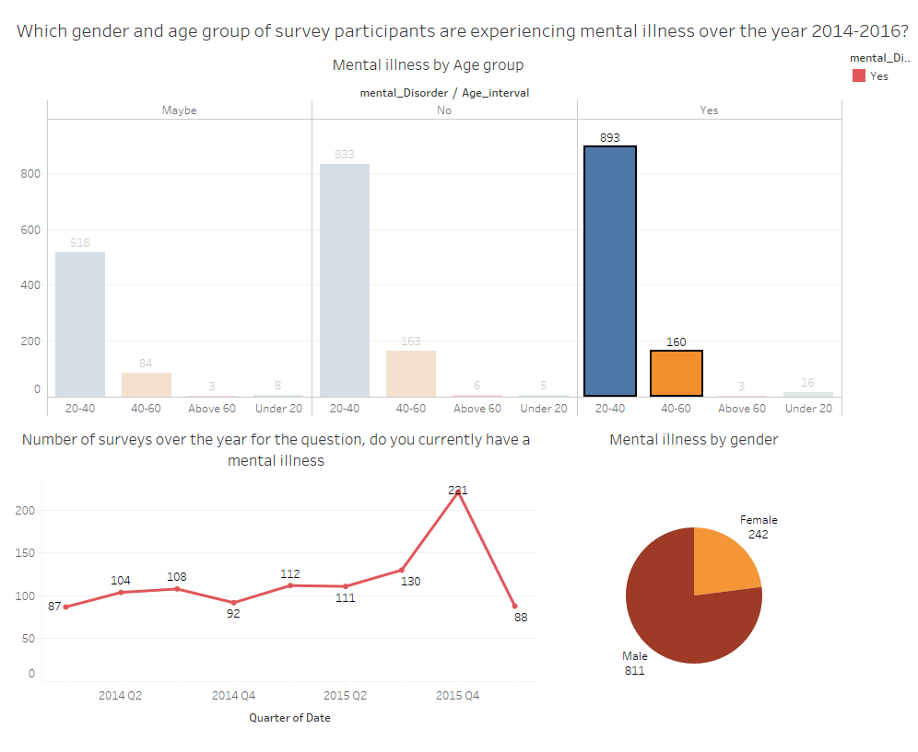
DASHBOARD 3a

Slide 8
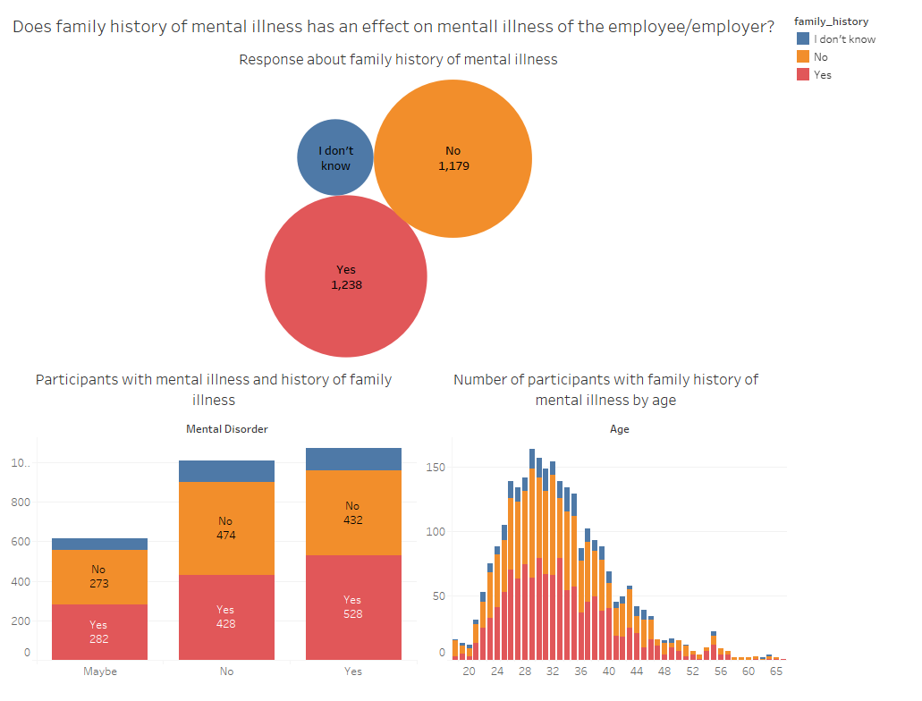
DASHBOARD 4

Slide 9
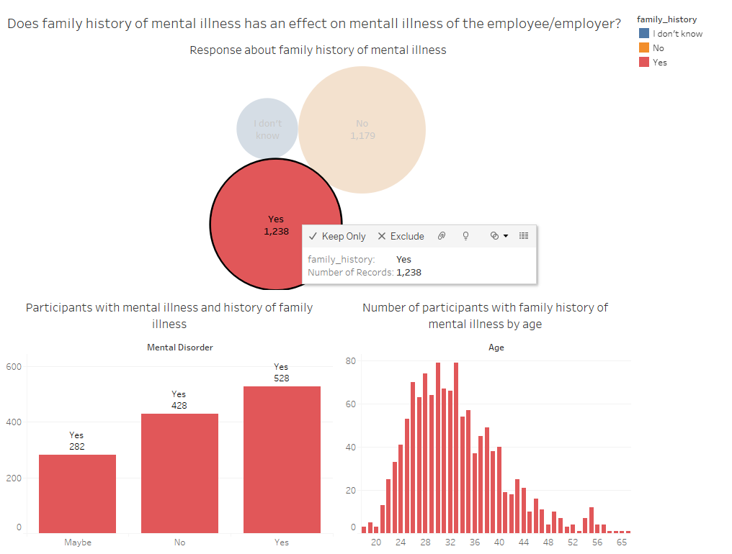
DASHBOARD 4a

Slide 10
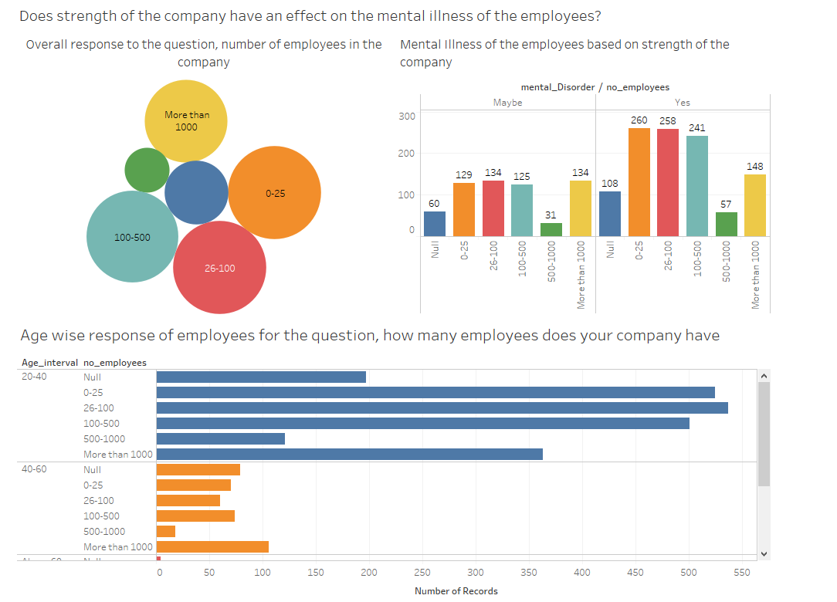
DASHBOARD 5

Slide 11
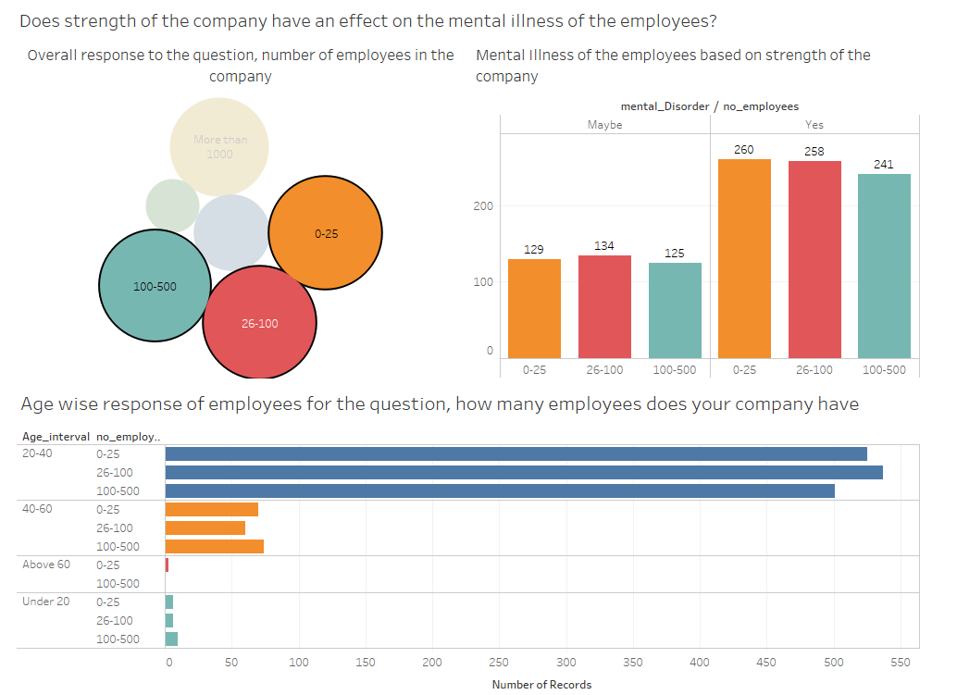
DASHBOARD 5a

Slide 12
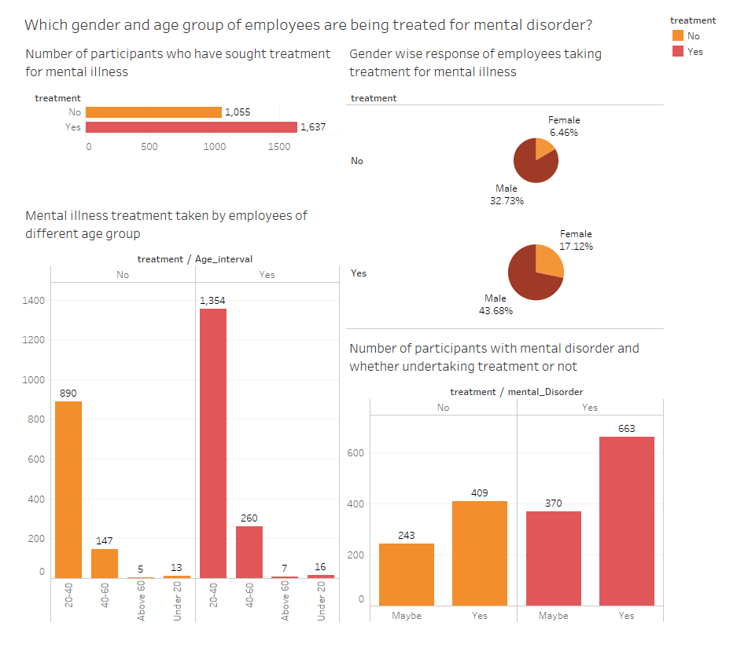
DASHBOARD 6

Slide 13
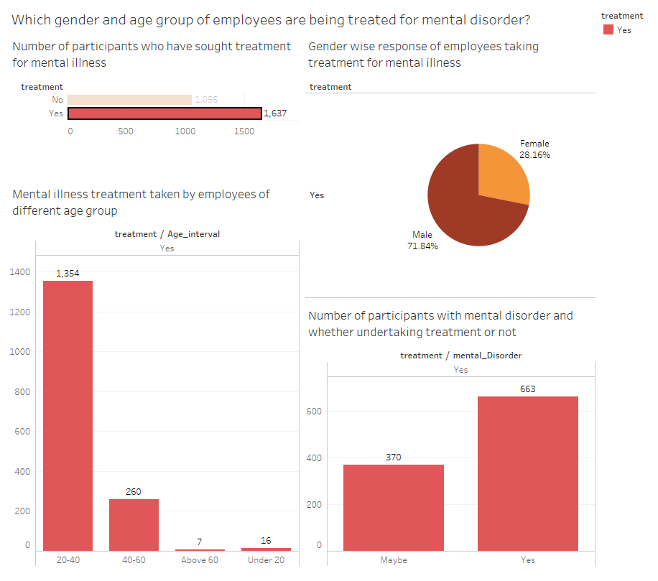
DASHBOARD 6a

Slide 14
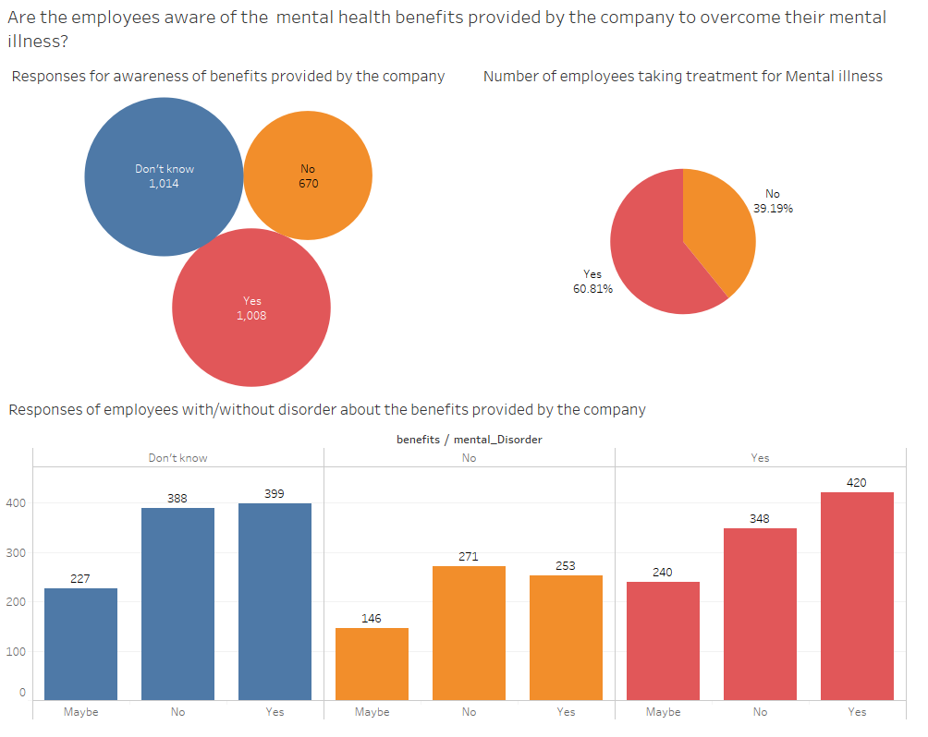
DASHBOARD 7

Slide 15
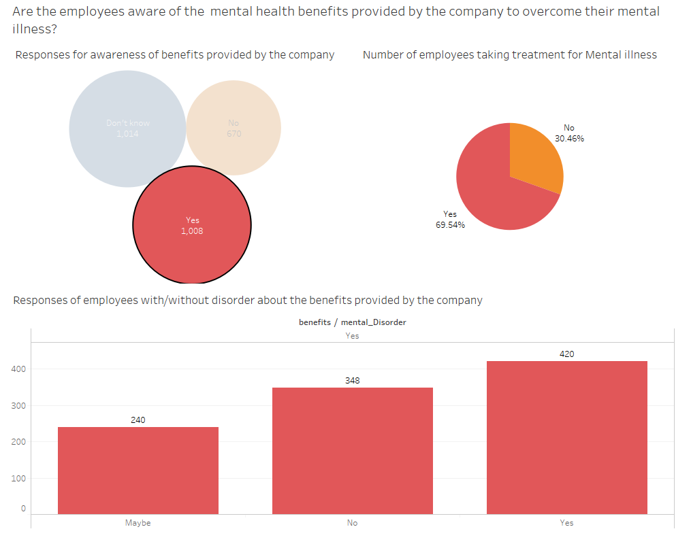
DASHBOARD 7a

Slide 16
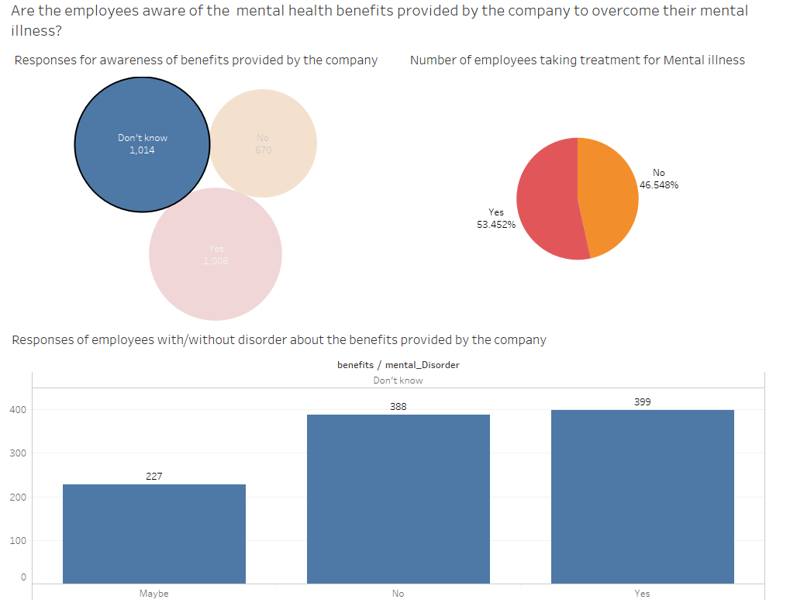
DASHBOARD 7b

Slide 17
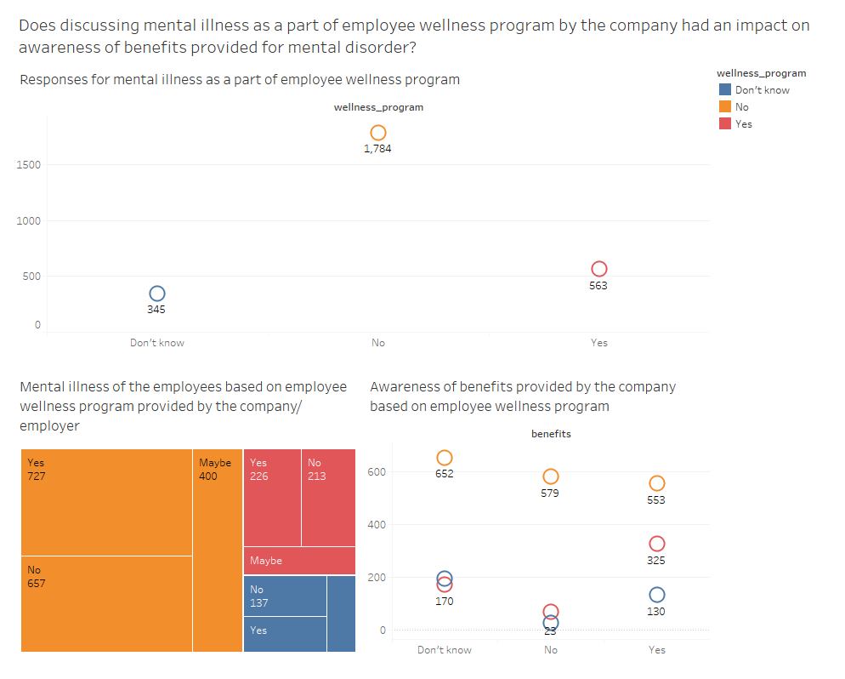
DASHBOARD 8

Slide 18
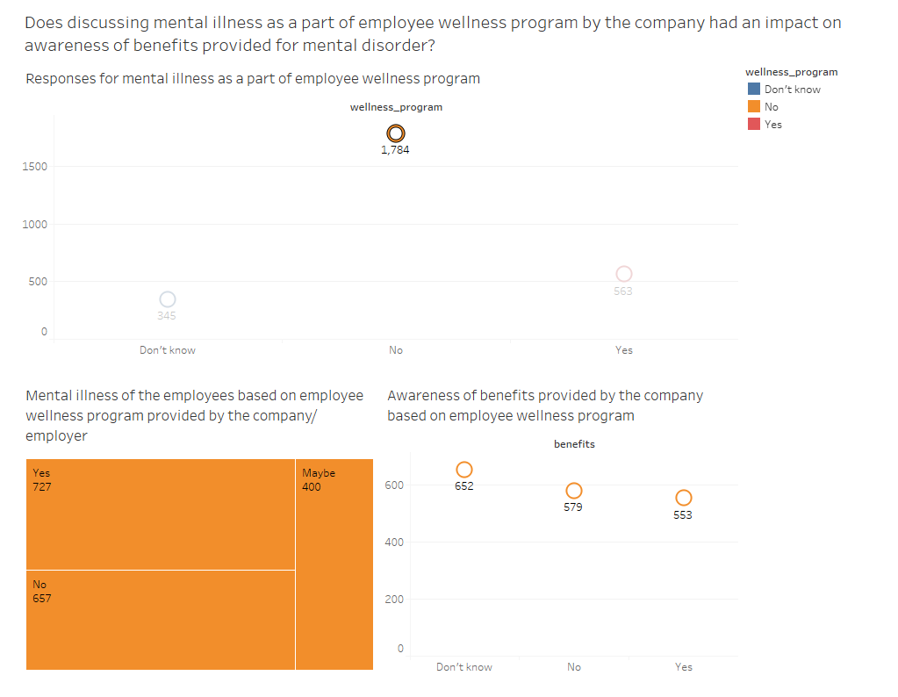
DASHBOARD 8a

Slide 19
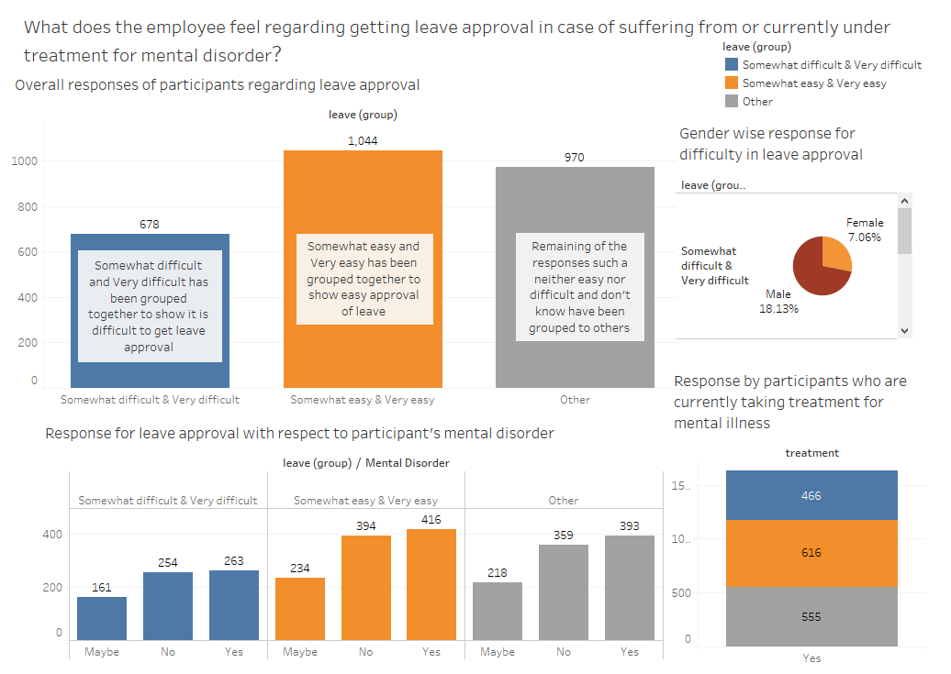
DASHBOARD 9

Slide 20
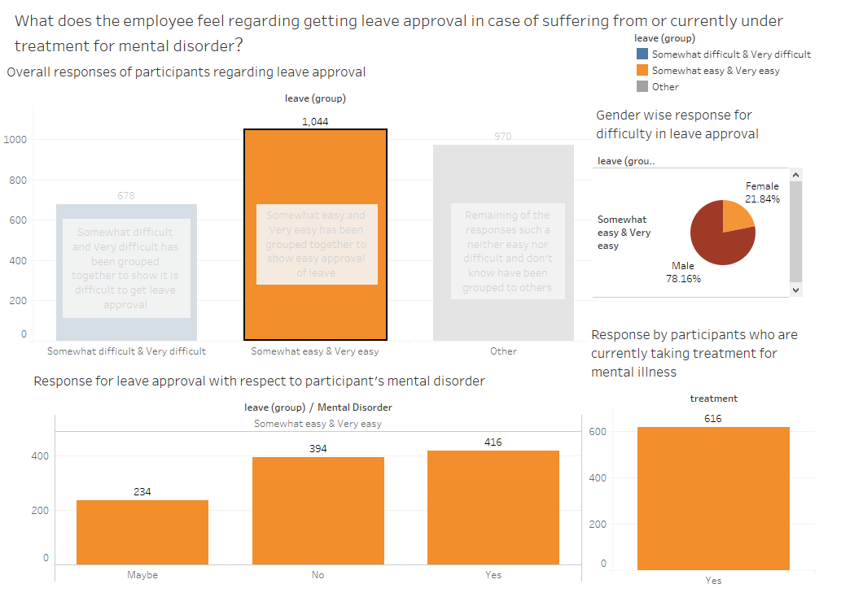
DASHBOARD 9a

Slide 21
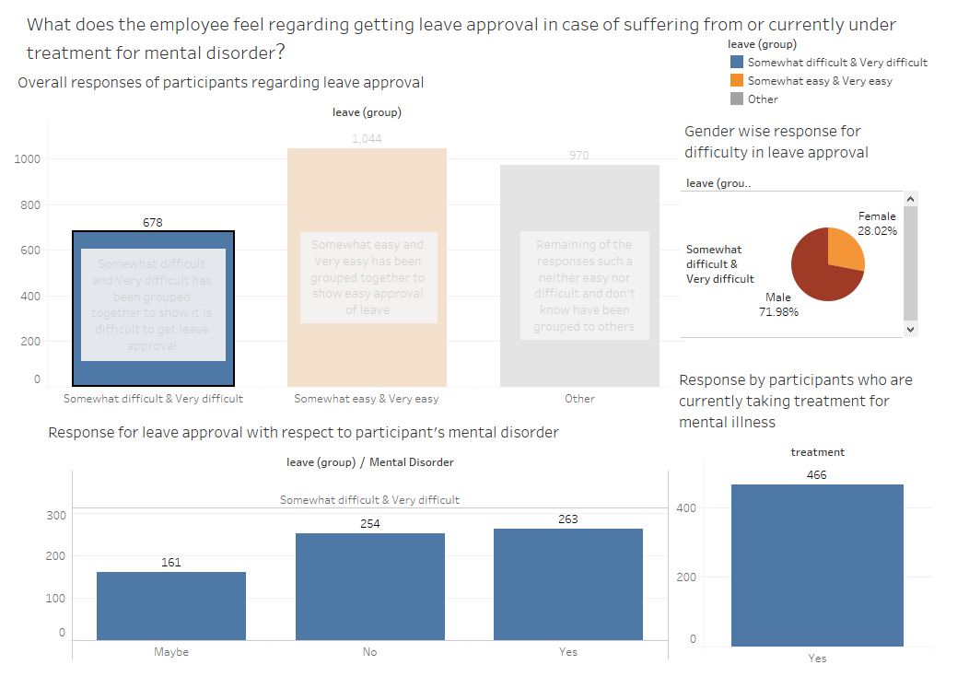
DASHBOARD 9b

Slide 22
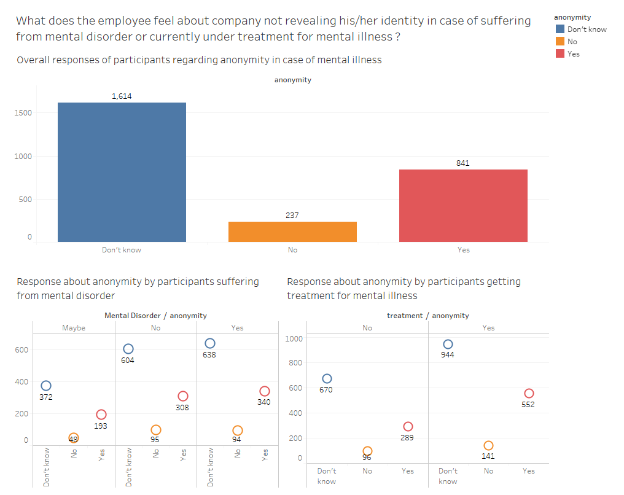
DASHBOARD 10

Slide 23
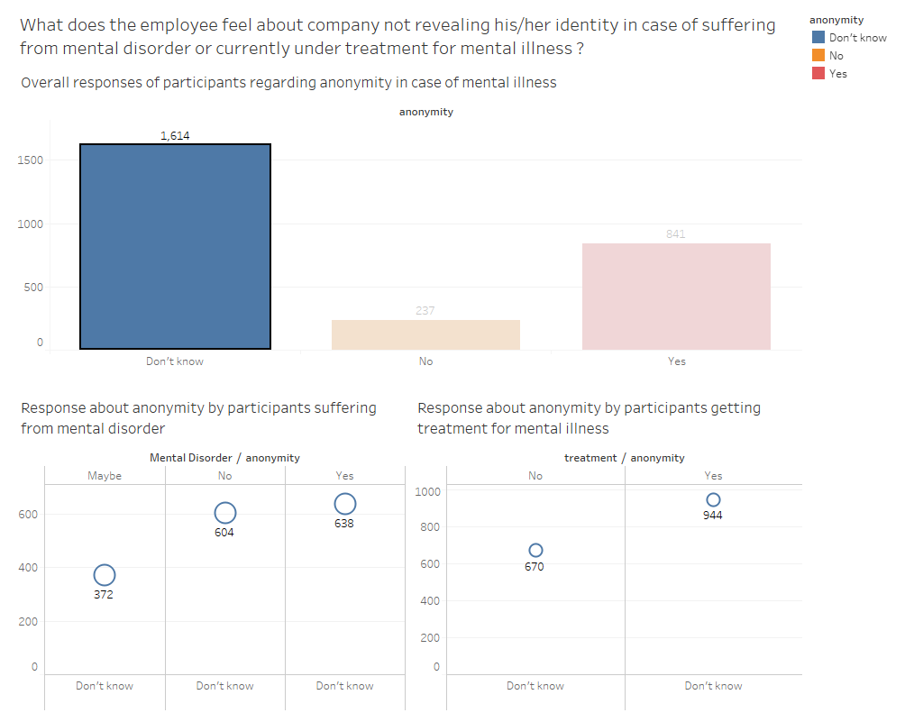
DASHBOARD 10a

Slide 24
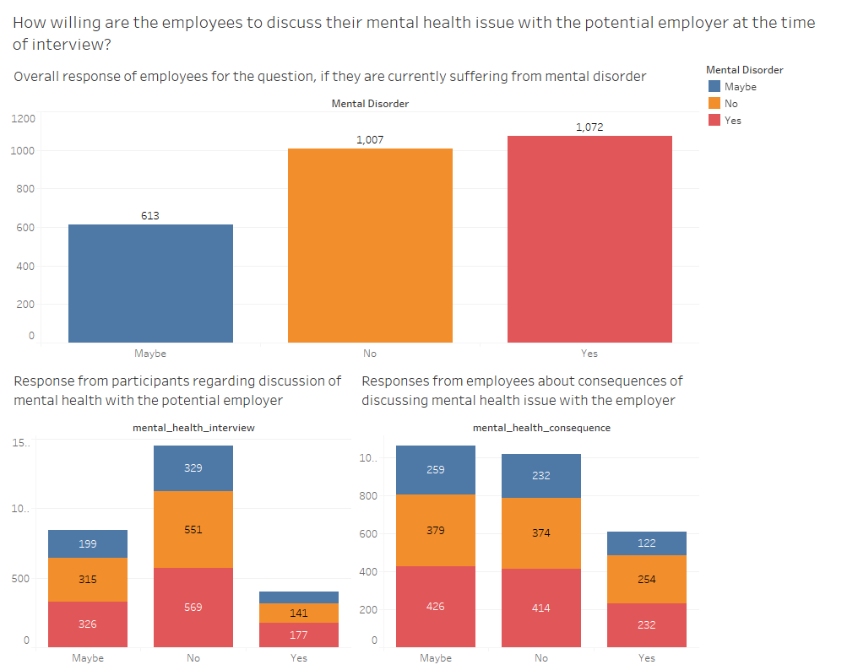
DASHBOARD 11

Slide 25
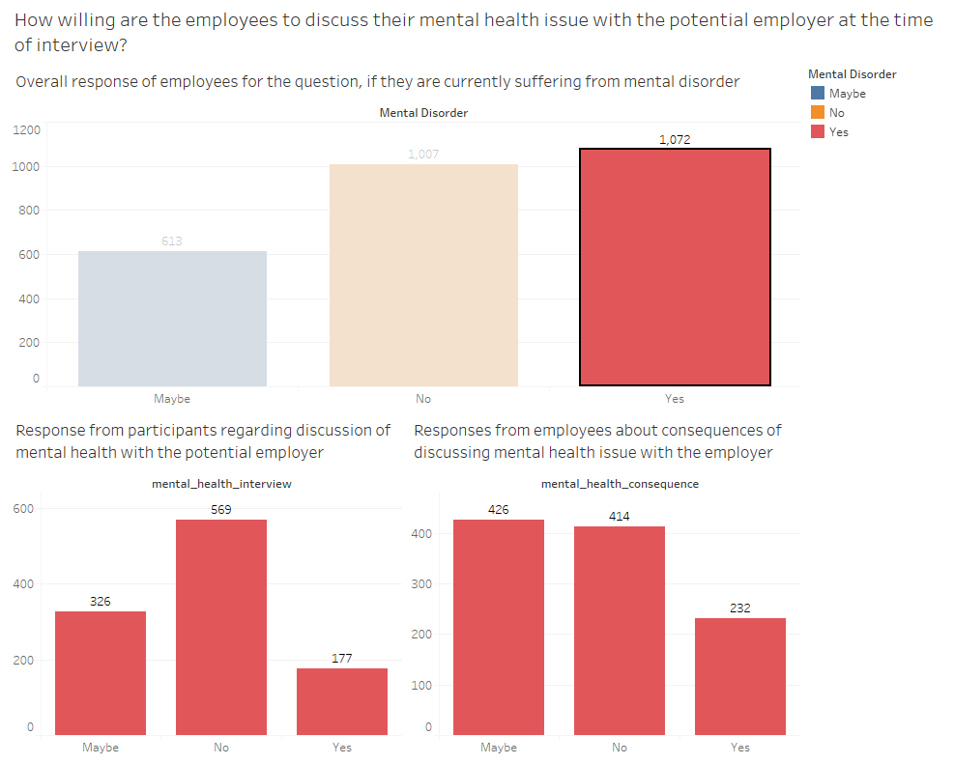
DASHBOARD 11a

Slide 26
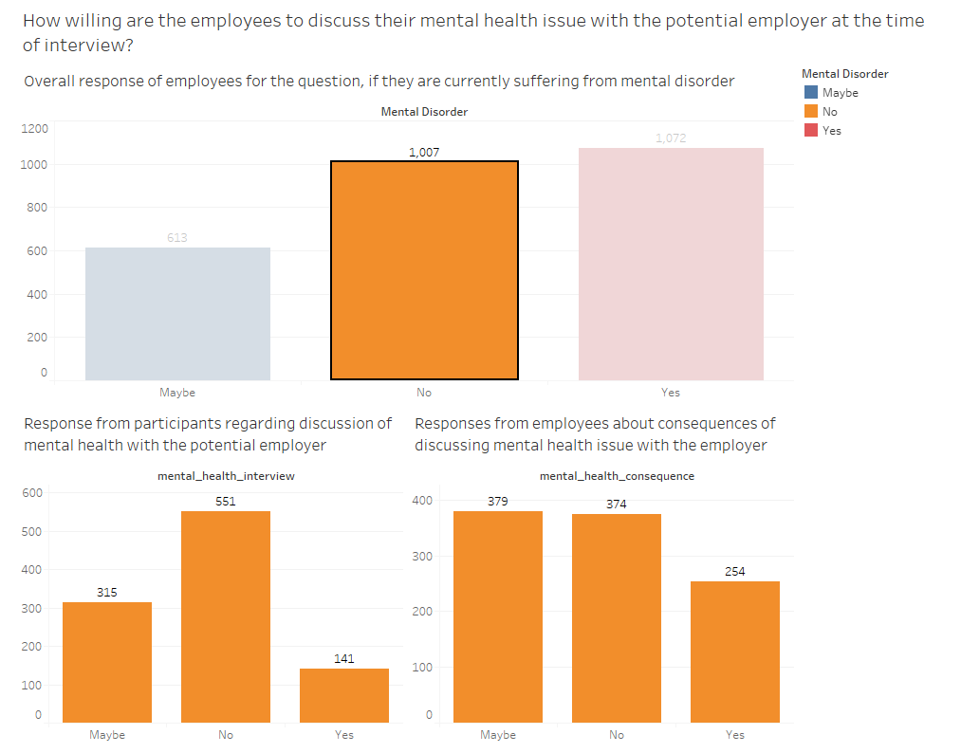
DASHBOARD 11b

Slide 27
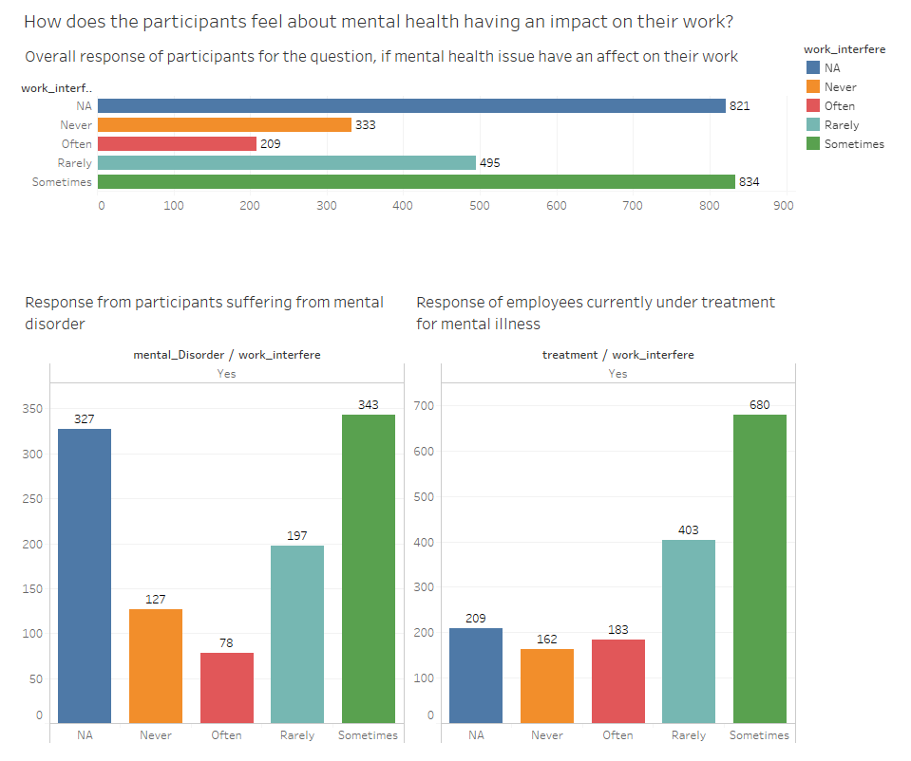
DASHBOARD 12

Slide 28
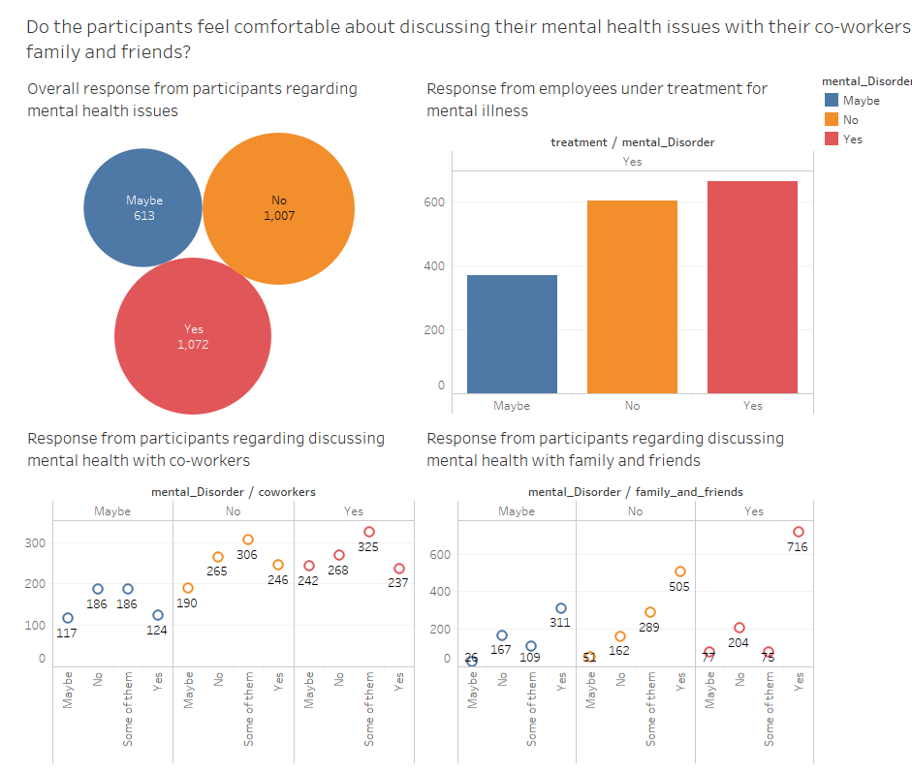
DASHBOARD 13

Slide 29
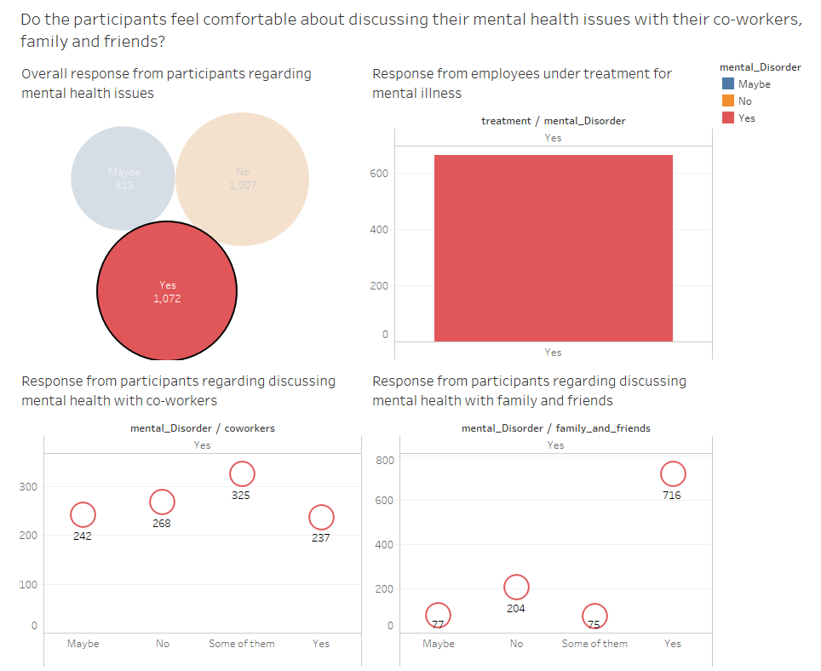
DASHBOARD 13a

Slide 30
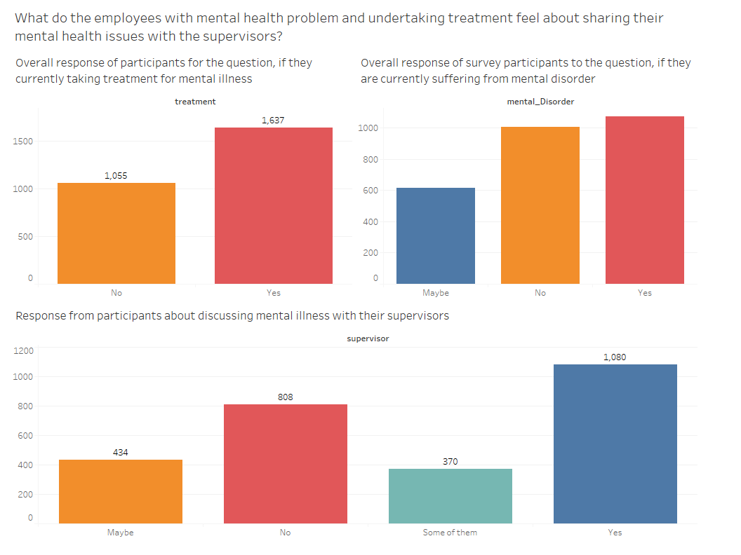
DASHBOARD 14

Slide 31
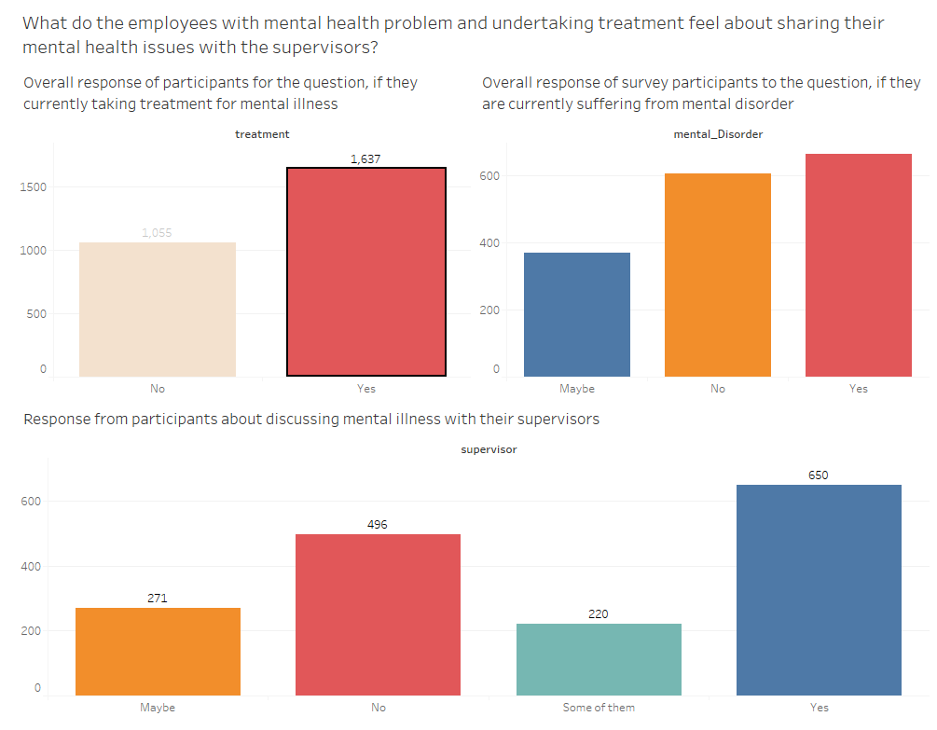
DASHBOARD 14a

Slide 32
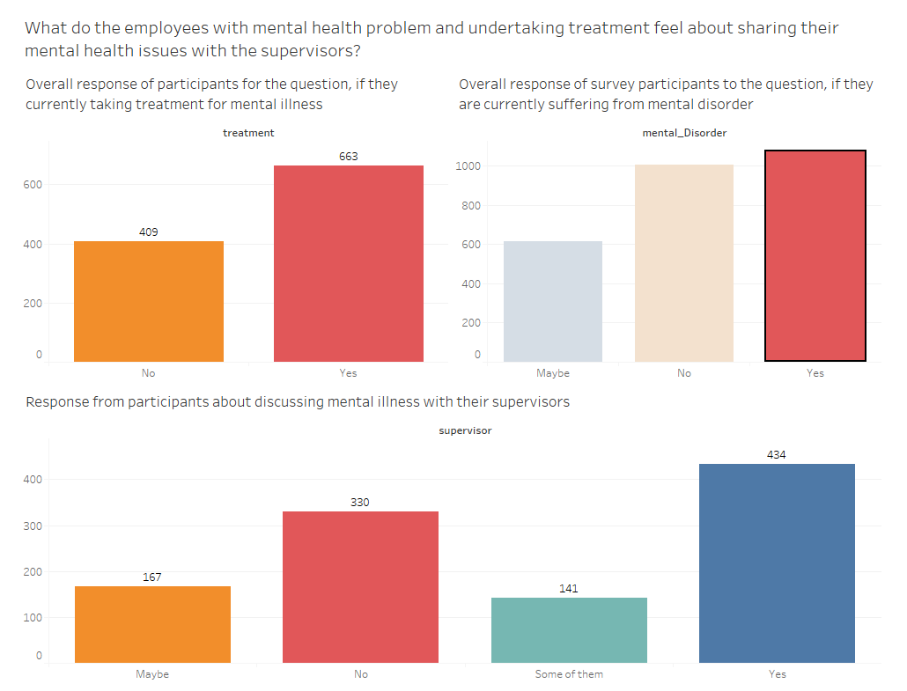
DASHBOARD 14b

Slide 33
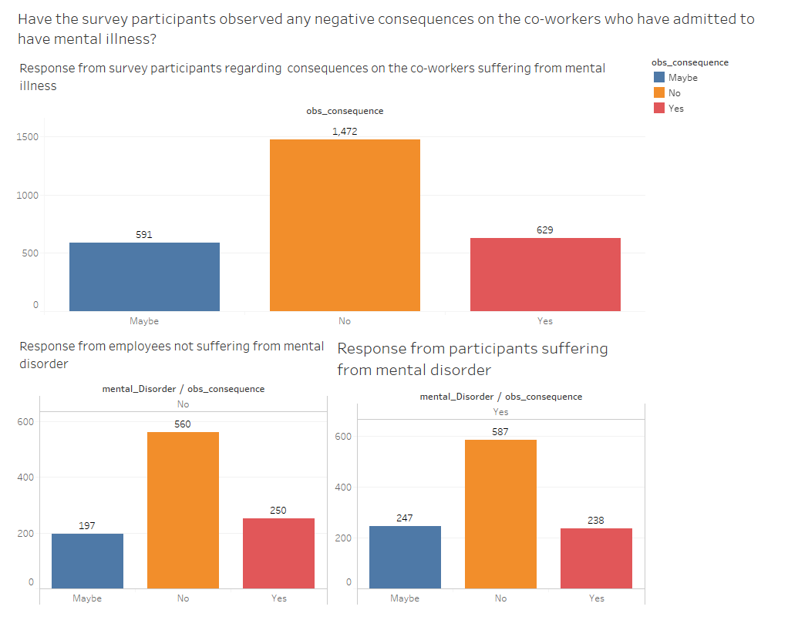
DASHBOARD 15

Slide 34
PART 2- PREDICTIVE ANALYTICS
Since our survey data contains mostly categorical variables and ‘yes’ and ‘no’ responses, we employ methods such as association rule, decision tree and clustering for predictive analytics of mental disorder in employees working in tech company
Questions to be answered
1. Is the mental disorder associated with other attributes such as number of employees, benefits provided by the company, etc?
2. Can the mental disorder be classified using other information such as treatment, discussing with supervisor, co-worker, friends and family, etc?
3. Is there a relationship between set of responses that are similar and can be grouped separately from other responses belonging to another group?

Slide 35
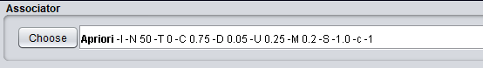
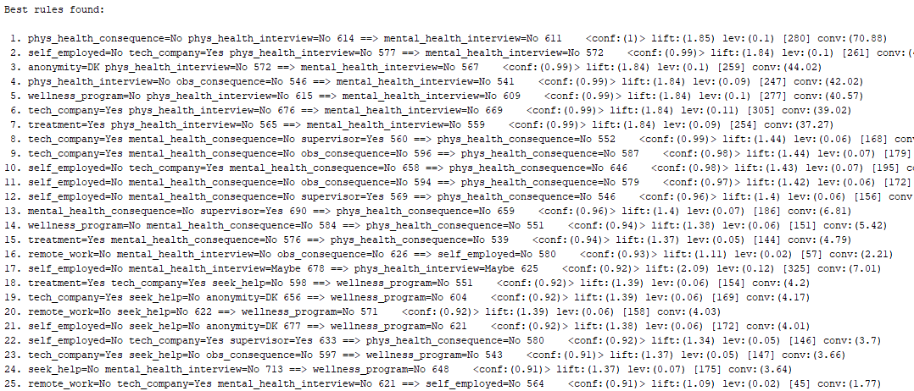
Analysis 1 : Association rule

Slide 36
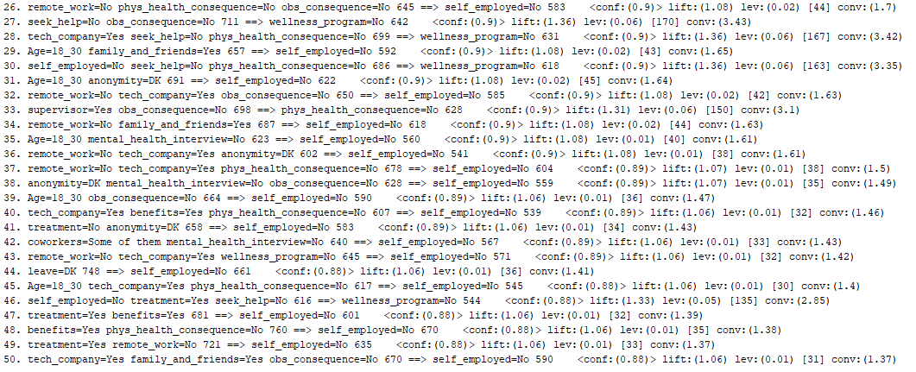
Analysis 1 : Association rule

Slide 37
Association rule: Interesting rules

Slide 38
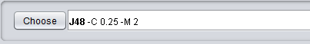
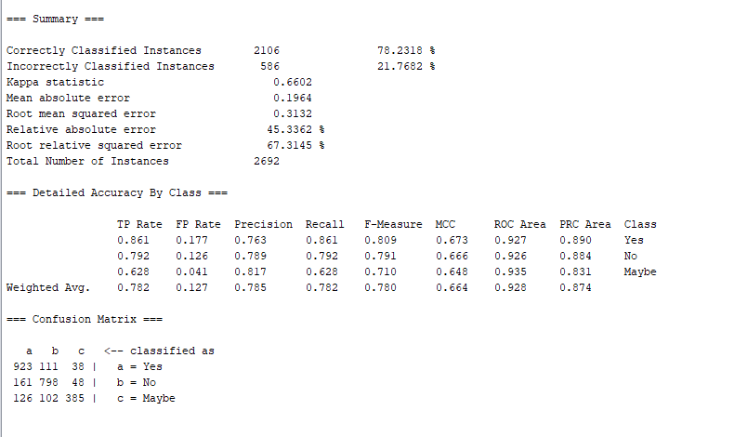
Analysis 2: Decision Tree

Slide 39
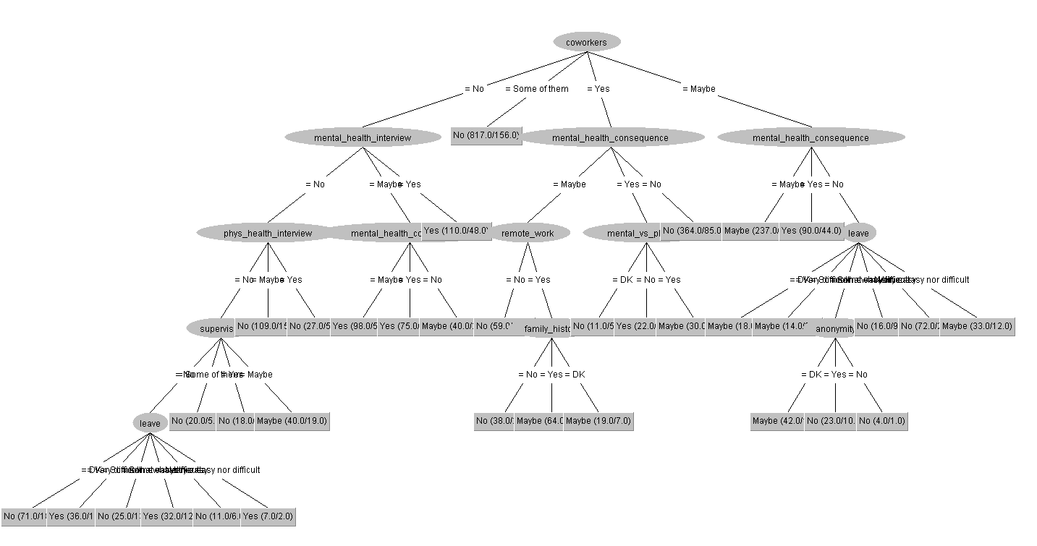
Decision Tree: Visualisation of tree

Slide 40
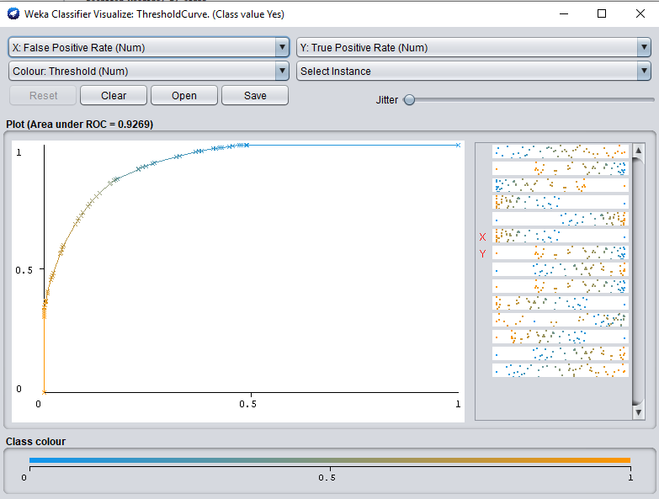
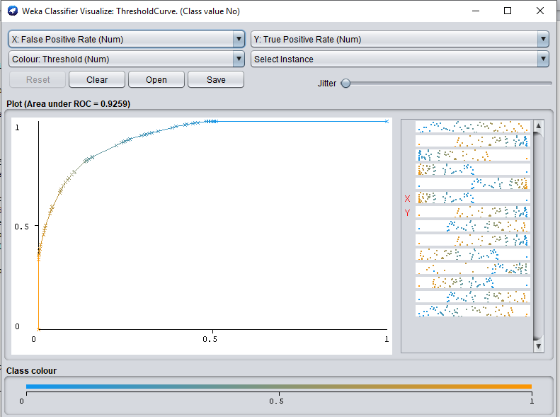
Decision Tree: ROC curve

Slide 41
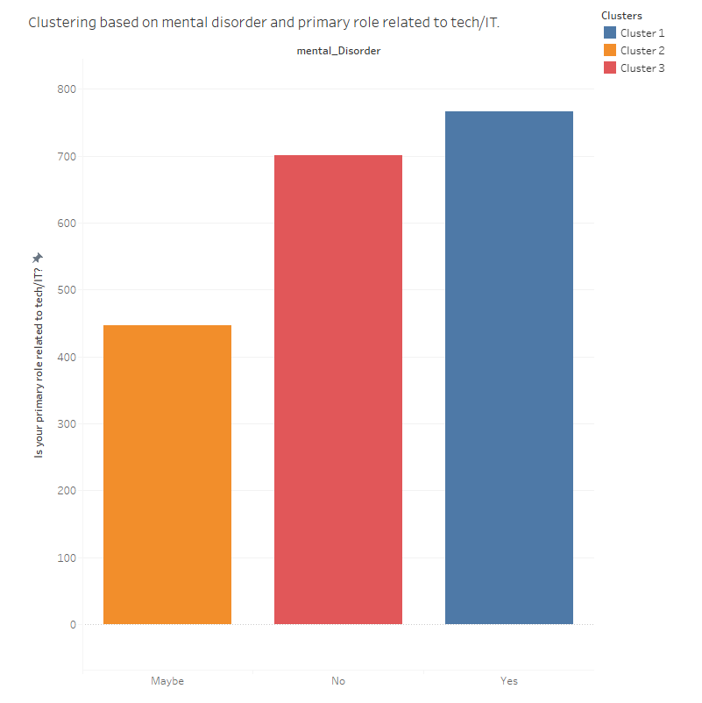
Analysis 3: Clustering

Slide 42
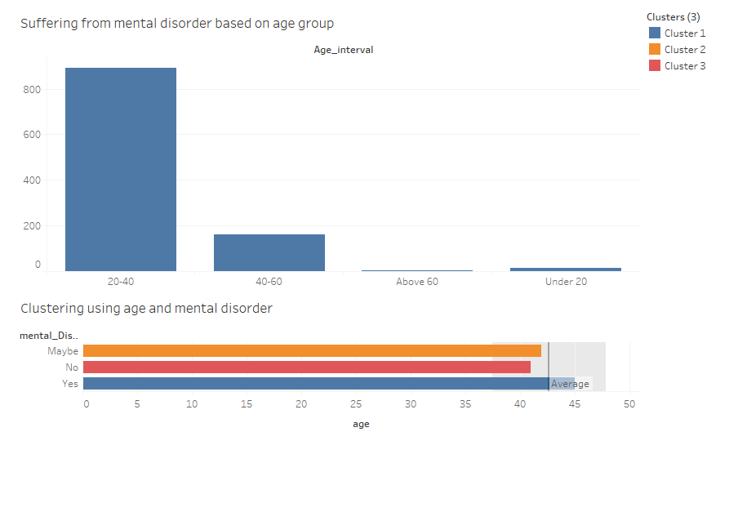
Analysis 4: Clustering

Slide 43
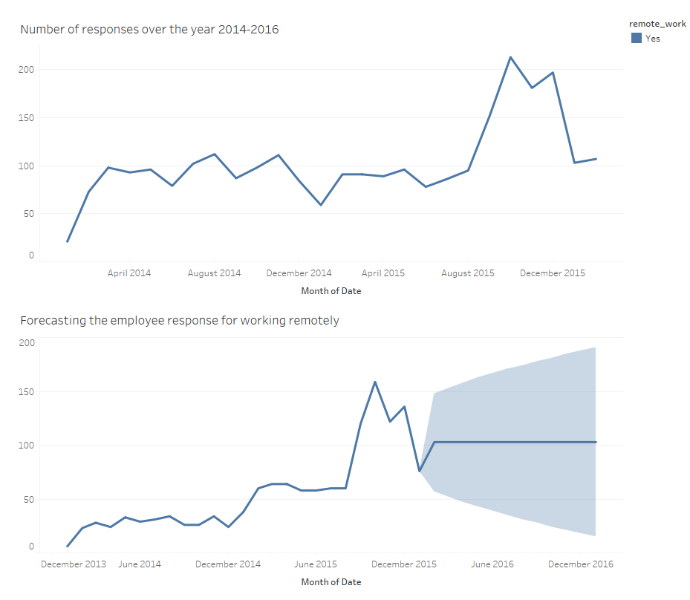
Analysis 5: Time Series Forecasting

Slide 44
Overall Insights
40% of the participants are currently suffering from mental disorder.
60% of the participants are taking treatment for mental disorder.
Most of the people suffering from mental disorder have family history of mental illness.
Many employees suffering from mental disorder are not aware of the benefits provided by the companies.
Mental disorder is high in employees working in small companies.
Most them feel comfortable sharing their mental issue with their friends and family than sharing with their co-workers or supervisors.
Many employees suffering from mental disorder feel it is easy to get leave approval.
Also, majority of the people suffering from mental illness are not sure about companies protecting their identity in case of confessing about mental health problem.
Participants suffering from mental disorder also feel this might impact their productivity and have negative consequences when discussed with the potential employer.
Another noticeable insight is that mental disorder is more concentrated in people with age group 20-50.

Slide 45
Actionable insights
Learn about family history of illness in advance.
Conduct seminars to acquaint them with the policies of the company.
Hire more employees if the budget permits.
Provide resources to understand the benefits and preservation of identity.
Provide mental health insurance and dedicated leaves for mental illness.
Conduct regular counselling sessions.

